Slide 1

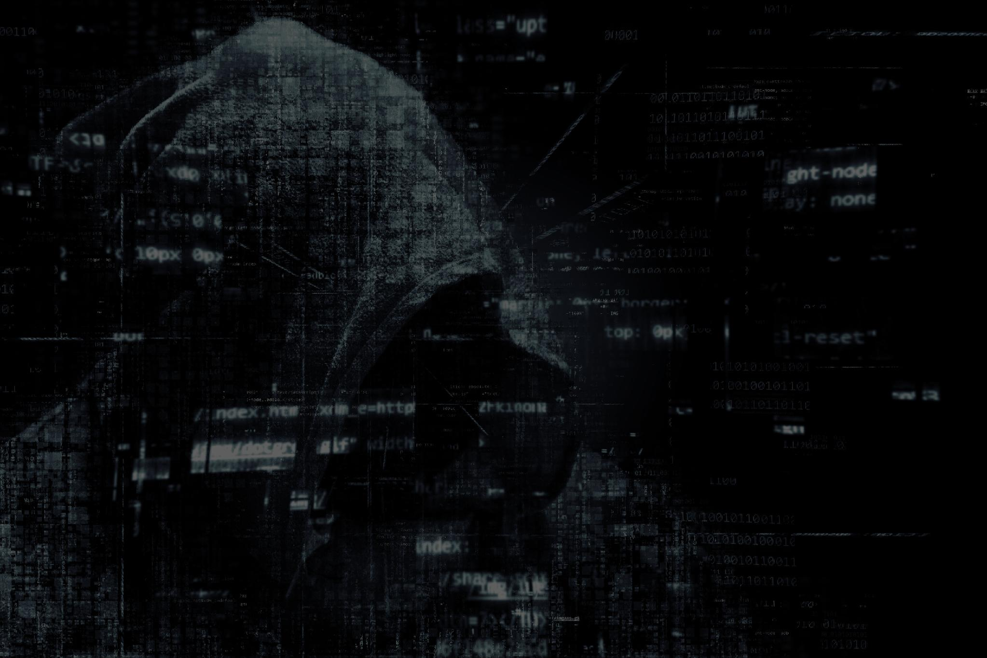


Phishing URL Detection using Neural Networks
Course
Computer Security (section: A)
Instructor
Md. Taky Shaharair
MEMBERS
1. PARTHO MAJUMDAR(011222042)
2. JANNATUL NAIMA(011222266)
3. MD. SIAM AFROZ TANMOY (0112230123)
01

Slide 2


Introduction
What is Phishing?
Fake websites steal personal information.
They look like real websites.
Users may lose passwords or bank information.
Why is it a problem?
Phishing attacks are increasing every year.
Traditional blacklist methods cannot detect many new phishing websites.
Fast and accurate detection is needed.
02

Slide 3
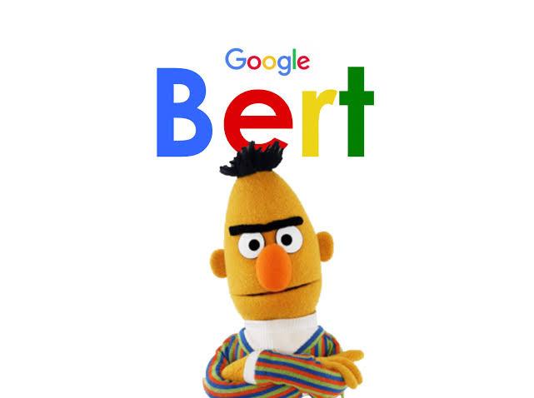


State of the Art
Current Research
Uses Machine Learning and Deep Learning.
Uses BERT-based Neural Networks.
Uses large datasets:
Alexa
PhishTank
OpenPhish
EasyDMARC
Achieves around 97% accuracy.
Successfully tested in a real production environment.
Key Contribution
✔ High accuracy
✔ Real-world deployment
✔ Confidence score using Probabilistic Neural Network
03

Slide 4
State of the Art Summary
Feature | Current Paper
Model | BERT + Neural Network
Dataset | Alexa, PhishTank, OpenPhish, EasyDMARC
Accuracy | ~97%
Production Tested | Yes
Confidence Score | Yes
04

Slide 5
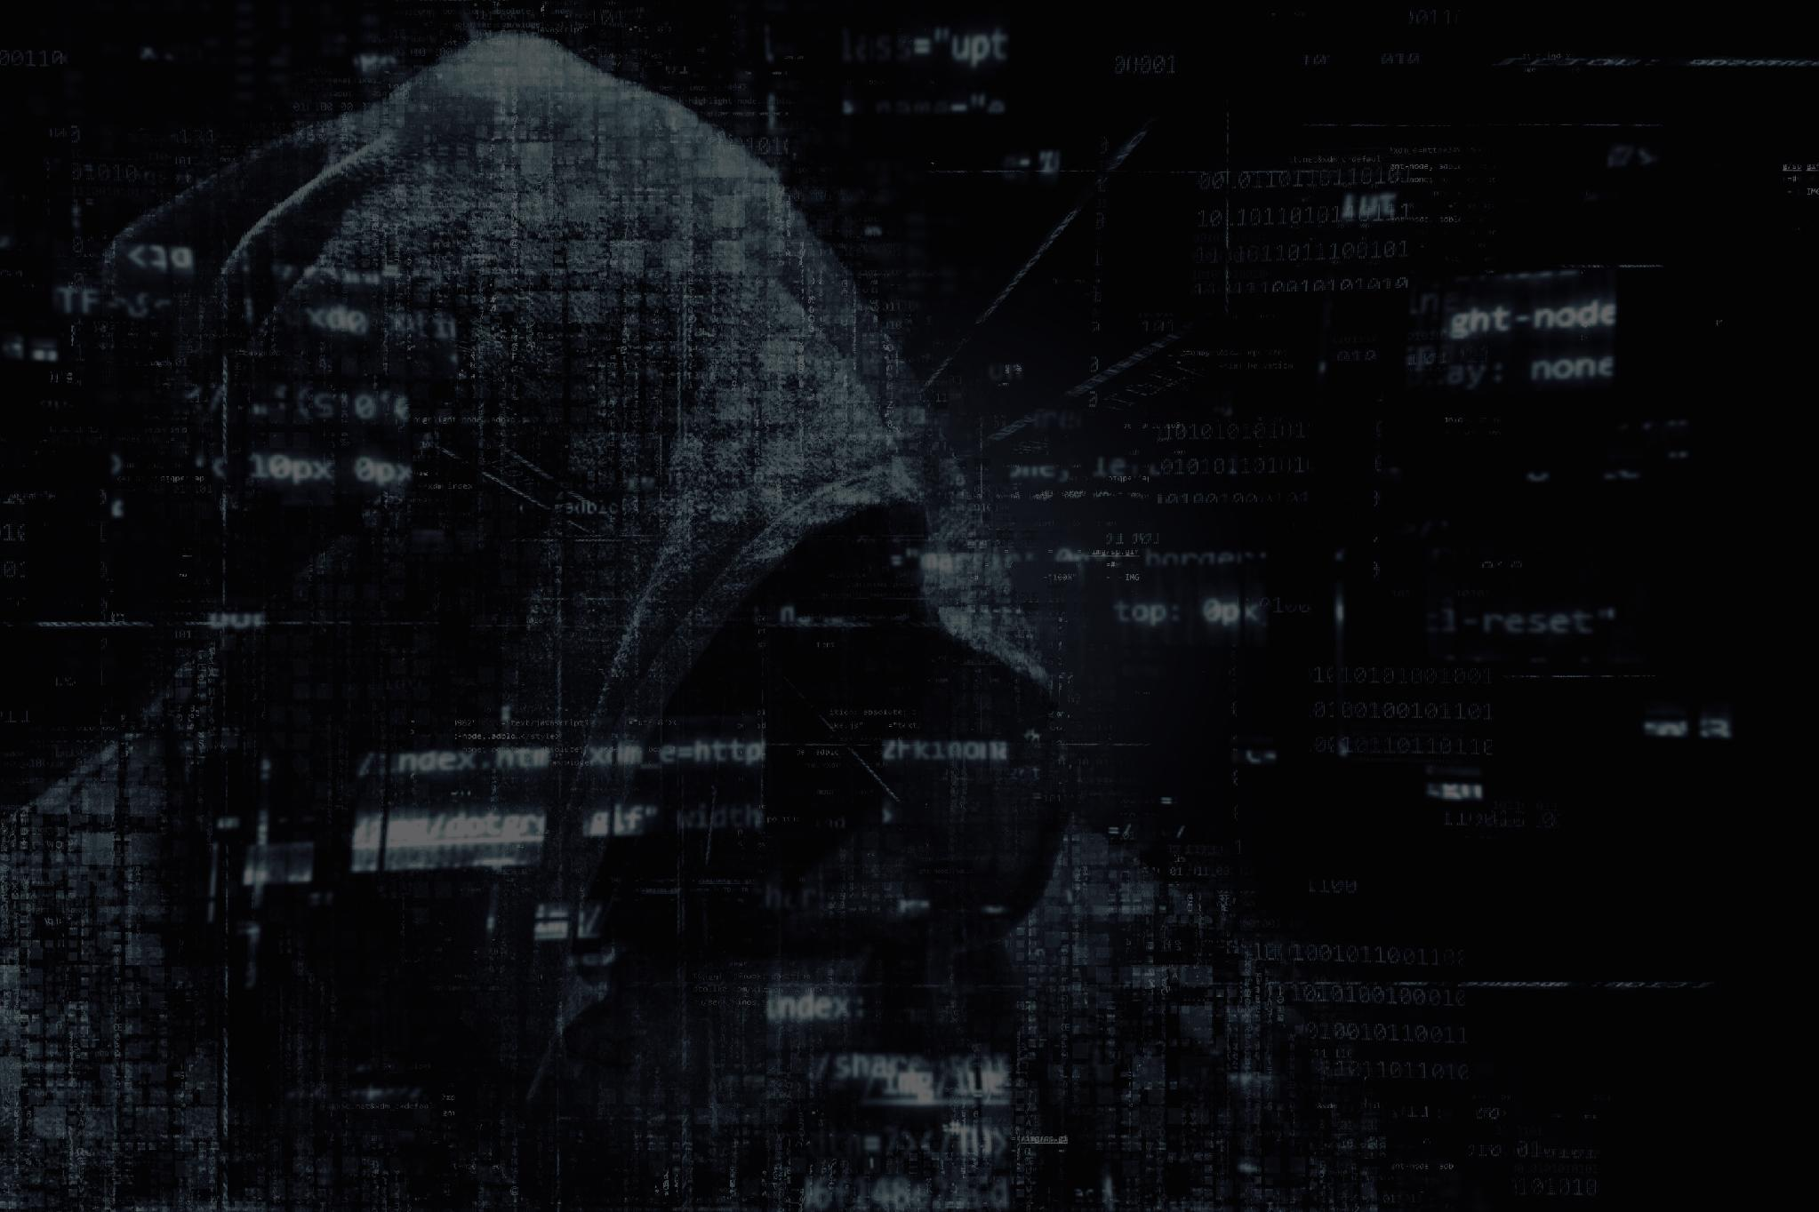


RECENT ADVANCEMENTS ON THIS FIELD
CNN, Bi-LSTM for URL pattern learning
Transformer-based models (BERT, DistilBERT)Hybrid deep learning models
Multimodal detection (URL + HTML + Visual)
Improved zero-day phishing detection

Slide 6



RESEARCH GAP ANALYSIS
Limited detection of unseen phishing URLs
Dependence on outdated or imbalanced datasets
Insufficient use of contextual website information
High computational complexity
Limited model interpretability
06

Slide 7
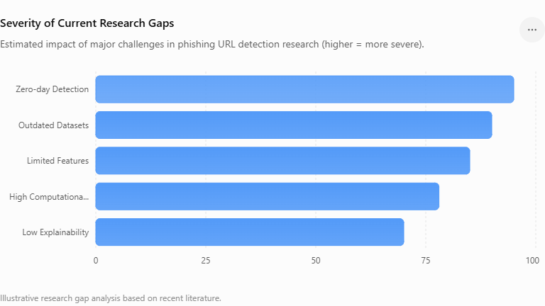
SEVERITY OF CURRENT RESEARCH GAPS
07

Slide 8
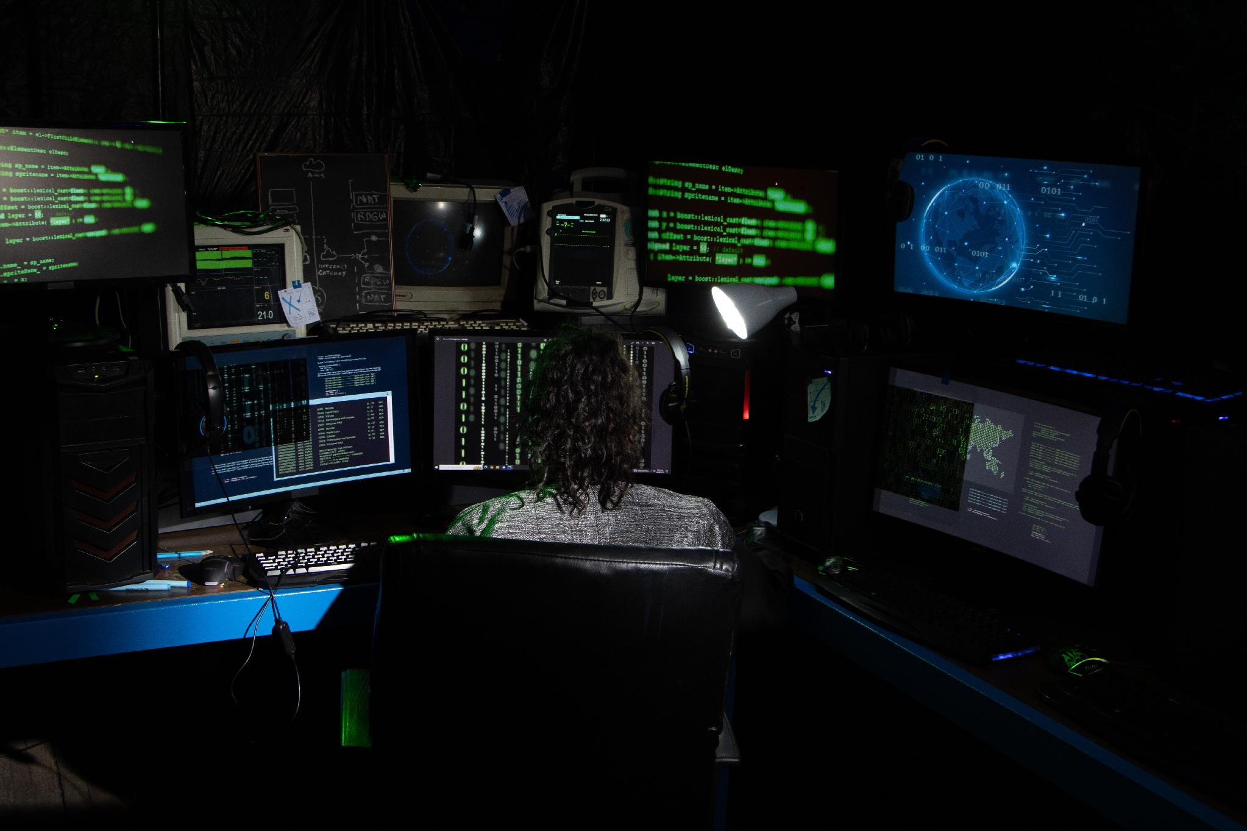
FUTURE RESEARCH DIRECTION
Develop lightweight and efficient models
Integrate multiple data sources (URL, HTML, DNS, SSL)
Build adaptive models for evolving attacks
Apply Explainable AI (XAI) for transparent decisions
Improve real-time and zero-day phishing detection
08

Slide 9
IMPROVEMENT
GAP:
The model was trained on old data. Also, no real-time adaptation. Hackers invent new tricks every week. Future phishing attacks may look different.
Solution:
Build Multimodal AI (webpage HTML, images, logo, screenshot, login page design, SSL certificate, JavaScript behavior)
09

Slide 10
IMPROVEMENT
GAP:
The model is trained once on old data and never explains why it made a decision.
Solution:
Zero-day phishing: add continual learning for daily updates and Explainable AI to help experts understand each prediction.
10

Slide 11
IMPROVEMENT
GAP:
It does not evaluate multilingual or Unicode URLs, domain/IP relationships, or robustness against adversarially modified URLs.
Solution:
Incorporating multilingual support, GNNs for domain/IP relationship analysis, and adversarial training to improve robustness
11

Slide 12

THANK YOU
ANY QUESTIONS?
12

Slide 13
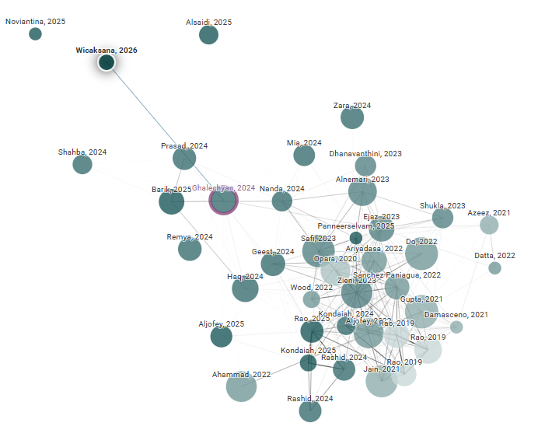

Slide 14
NEW PAPERWORK BASED ON OLD PAPER
HTTPS://JOURNAL-ISI.ORG/INDEX.PHP/ISI/ARTICLE/VIEW/1543/744
HTTPS://LINK.SPRINGER.COM/ARTICLE/10.1007/S41870-025-02597-8
HTTPS://IEEEXPLORE.IEEE.ORG/DOCUMENT/11193051/
10

